Slide 1
Topic 2 :Google Penguin and Panda (part 1)
ST2228 WEB AND MOBILE
ANALYTICS

Slide 2
Learning Objectives
Google timeline for major search process
Objective of Google Penguin
Impacts of Google Penguin
Signs that you have been penalized
How to make your site more legitimate?
Goole Penguin and Link Pruning

Slide 3
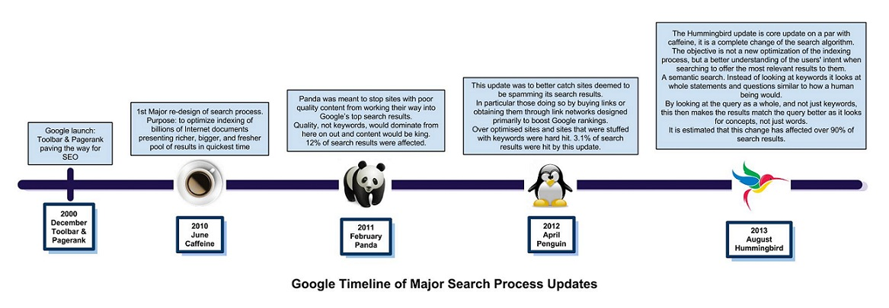
Google Timeline of major search process

Slide 4

Google Penguin and Panda

Slide 5

Objective of Google Penguin

Slide 6

Objective of Google Penguin
Penalize link building schemes
  Keyword stuffing
    Use one keyword phrases in thousand of text links
  Link farming
    Trying to increase the number of sites that link to yours
  Excessive link exchanges
  Buying or selling links solely to increase page ranking
Prevent “over-use” of keyword phrases in anchor text
Prevent spammers selected high-traffic keyword phrase and used in thousands of text links on multiple websites

Slide 7
Impacts of Google Penguin
Google also penalize paid advertorials that violate guidelines
  Example pass page rank
Guest blogging
  Posts submit by bloggers that are not highly relevant and “natural” may be considered as low quality links
De-index low quality sites
Google not only penalize the sites that they consider artificial, they also penalize the sites those links are pointing to

Slide 8
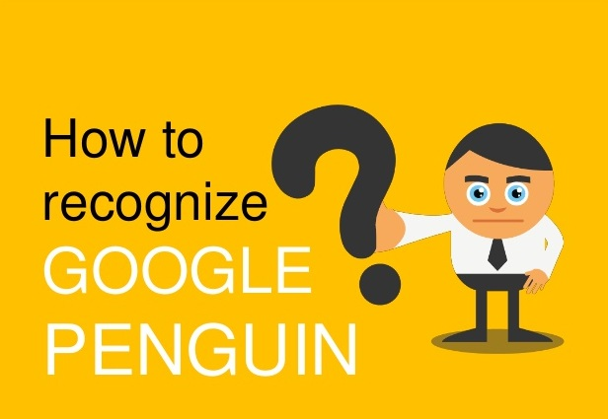
Am I penalize?

Slide 9
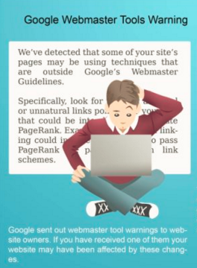
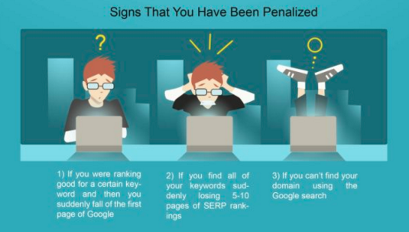
Signs that you have been penalized

Slide 10
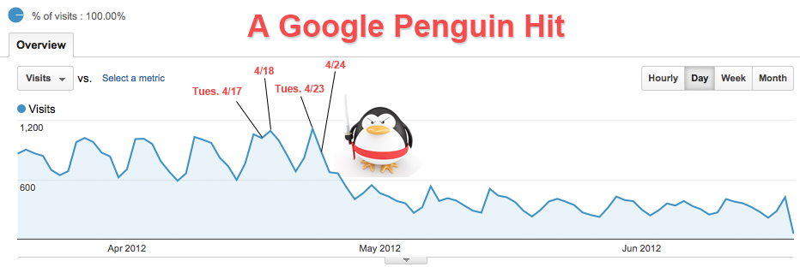
Signs that you have been penalized

Slide 11
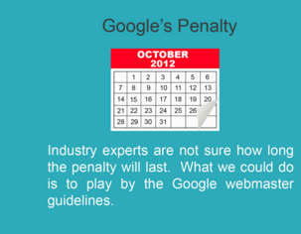
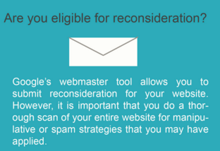
Signs that you have been penalized
Source: Spaghettibowl.com

Slide 12
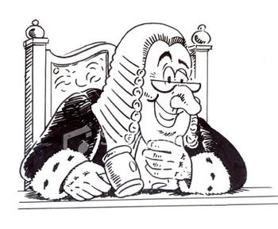

How to make your site more legitimate?

Slide 13
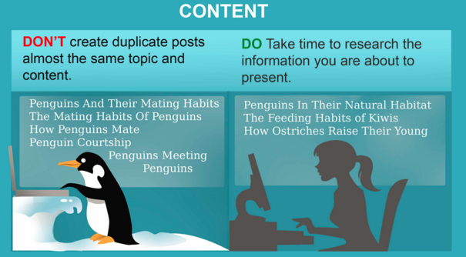
How to make your site more legitimate?

Slide 14
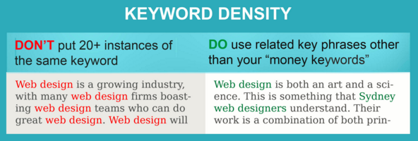
How to make your site more legitimate?

Slide 15
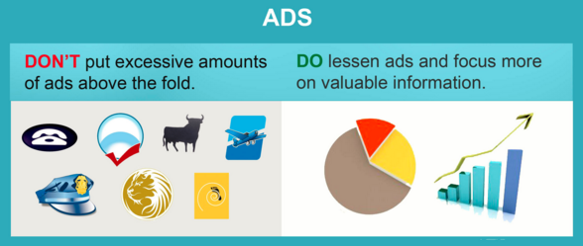
How to make your site more legitimate?

Slide 16
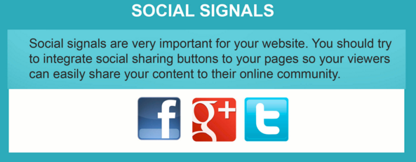
How to make your site more legitimate?

Slide 17

How to make your site more legitimate?

Slide 18
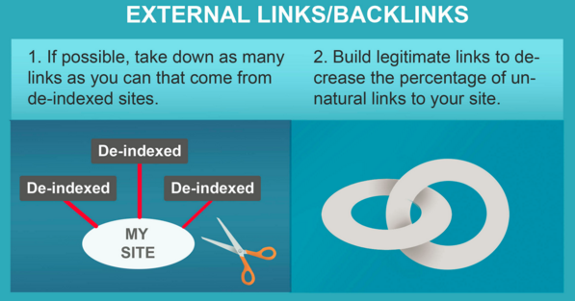
How to make your site more legitimate?

Slide 19
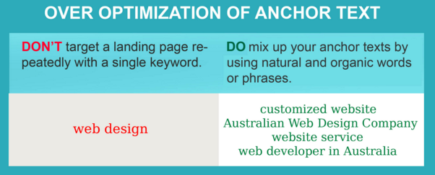
How to make your site more legitimate?

Slide 20
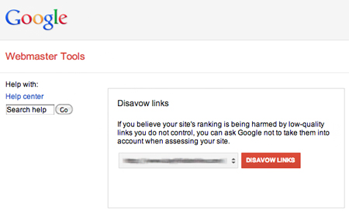
Goole Penguin and Link Pruning
Link Pruning = Link removal process
Determine the quality of the inbound links using tools such as Google Webmaster tools and other proprietary link tool such as Majestic SEO
Contact the website administrators to have link removed
Otherwise use Google’s Disavow tool if links
cannot be removed
Repeat the steps

Slide 21
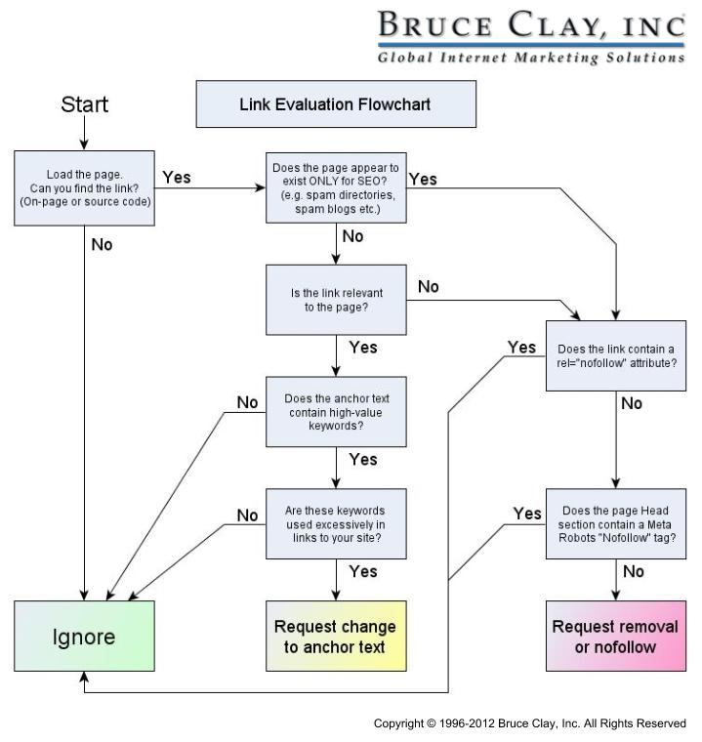
Goole Penguin and Link Pruning
“Nofollow” provides a way for webmaster to tell Google not to follow this page or don’t follow this link

Slide 22
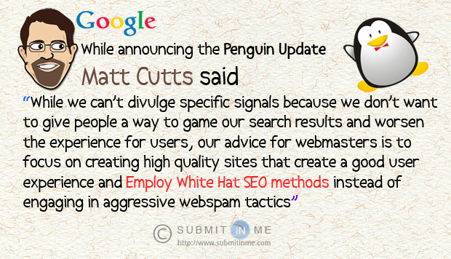
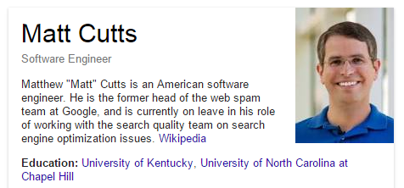
Google Penguin and Matt Cutts

Slide 23
Reference
Have the Hummingbird, Panda & Penguin caused your website visitors to disappear? Quite possibly., Bruce Joubert, 10th April 2014, http://blog.realpoint.co.uk/1421/hummingbird-panda-penguin-eaten-your-site-visitors/
INFOGRAPHIC – How To Remedy Penguin and Panda Slaps, Spaghetti bowl news, http://www.spaghettibowl.com/spaghetti-bowl-news/infographic-how-to-remedy-penguin-and-panda-slaps/
Advanced Search Engine Optimization, Asia Search Engine Academy
Top 10 Google Penguin Infographics, Seoptimer Blog, Pawel Rabinek, 29th June 2012, http://www.seoptimer.com/blog/top10-google-penguin-infographics/3/
Google console help, Google, https://support.google.com/webmasters/answer/96569?hl=en
Doing Link Removal? Use This Flowchart to Quickly Evaluate Backlink Quality, Bruce Clay inc, June 2012, http://www.bruceclay.com/blog/link-removal-flowchart/

